Slide 1
Financial crises I Source: Reinhart and Rogoff Parts 1 and 2

Slide 2
Context
GFC was the largest financial crisis since the great depression
It also caused the deepest recession since the great depression (up to that point)
Legacy effects of the GFC have continued
a decade (approx.) of ultra low interest rates
debt overhang
destabilisation of euro area
banking fragility
impact on thinking about the monetary policy framework
This affected the environment for dealing with Covid impact
Covid + Ukraine + supply chain problems add further complexity
return of inflation

Slide 3
A brief recap
Evolution of thinking about monetary policy framework: from money targets (c.1975 - 85) to inflation targets (1990s -)
Inflation targeting is now the preferred framework in normal times
GFC brought to the fore questions about how the framework should deal with asset bubbles, financial stability and the ZLB
These questions are still not settled

Slide 4
Plan for remaining lectures
Financial crises I: Concepts, data and external debt crises (Reinhart and Rogoff parts 1,2)
Financial crises II: Domestic debt, banking and currency crises (RR 3,4)
Financial crises III: The GFC and its aftermath (RR 5,6); Firefighting
Wrap up lecture: Overview of the post GFC policy environment (Edey paper on the RBA and the GFC)

Slide 5
Preamble: themes of the book
“This time is different”
idea that risk taking is justified by some new development
Role of confidence in crisis episodes:
its ethereal nature
multiple equilibria
bank runs as an example

Slide 6
Bank runs
Vulnerability arises from a combination of features:
maturity mismatch in banking (borrow short, lend long)
assets are illiquid, but liabilities are repayable at short notice
assets are worth less in a fire sale than if held to maturity
Distinction between illiquidity and insolvency
In banking, illiquidity can cause insolvency
Solution: CB as lender of last resort (to illiquid but solvent banks)

Slide 7
A digression on the bank balance sheet
Central concept: Sources of funds = Uses of funds
Or equivalently, Liabilities (claims on assets) = Assets
The core business of a commercial bank is to take deposits and make loans
Hence, in a typical bank:
deposits are the largest item on the liabilities side of the balance sheet
loans are the largest item on the asset side
The main mechanism for making a profit is the net interest margin (that is, the difference between the average interest rates on deposits and loans)

Slide 8
The Bank Balance Sheet (2)
Liabilities (sources of funds):
Current (at-call) deposits
Term deposits
Non-deposit borrowings eg:
bonds sold to wholesale investors)
loans from other banks
Bank capital (shareholders’ funds)
raised directly from shareholders, or
retained earnings

Slide 9
The Bank Balance Sheet (3)
Assets (uses of funds):
Cash
Reserves (deposits) held at the central bank
Loans to other banks
Securities (eg government bonds, held as liquid assets)
Loans
Other assets (eg investments in subsidiaries, business premises)

Slide 10
The functions of capital and reserves
Capital sits on the liabilities side of the balance sheet
The function of capital is to absorb losses so that they don’t fall on other claim-holders
Reserves are an asset
The function of reserves is to meet unexpected outflows (eg, deposit withdrawals)

Slide 11
The balance sheet has to balance
By definition, Assets (A) have to equal total claims on those assets (Liabilities, L)
So: A = L
Note:
Some accounting treatments use an equivalent formulation that separately identifies capital (K) and non-capital liabilities (NKL)
Hence: A = K + NKL
or equivalently: K = A – NKL
This formulation makes clear that capital (K) represents the total claims of shareholders on the net assets of the banking firm

Slide 12
Liquidity Management and the Role of Reserves How reserves help protect a bank from illiquidity
Suppose a bank’s required reserves are 10% of deposits.
If a bank has ample excess reserves, a deposit outflow does not necessitate changes in other parts of its balance sheet.
If deposit outflows exceed reserves, the bank may become illiquid
It notionally has enough assets to repay depositors in full, but can’t convert them to cash quickly enough to meet the outflows
Initial position |  |  |  |  | After deposit outflow of $10M
Assets |  | Liabilities |  |  | Assets |  | Liabilities
Reserves | $20M | Deposits | $100M |  | Reserves | $10M | Deposits | $90M
Loans | $80M | Bank Capital | $10M |  | Loans | $80M | Bank Capital | $10M
Securities | $10M |  |  |  | Securities | $10M

Slide 13
Capital Adequacy Management How Bank Capital Helps Prevent Bank Failure
Capital (the value of shareholder claims) falls by the amount of the loss
If the loss exceeds the amount of capital, depositors can’t be repaid in full, so the bank fails (capital below zero)
Before loan losses |  |  |  |  | After loan losses ($5M of loans become unrecoverable)
Assets |  | Liabilities |  |  | Assets |  | Liabilities
Reserves | $5M | Deposits | $90M |  | Reserves | $5M | Deposits | $90M
Loans $95M |  | Capital | $10M |  | Loans $90M |  | Capital $5M

Slide 14
Numerical example of a bank run
Assets
Loans 90
Liquid assets 10
Total 100
After deposit run (outflow = 20):
Loans (sold at discount*) 75
Liquid assets (sold) 0
Total 75
* 15 units of loans sold at 2/3 face value
Liabilities
Deposits 95
Capital 5
Total 100
Deposits (95 – 20) 75
Capital 0
Total 75

Slide 15
Runs on government debt
Conclusion from previous slide: a ‘run’ can be self-fulfilling in some circumstances
Governments are also vulnerable to investor runs
They typically don’t have enough liquid assets to meet a sustained failure to roll over their debts
Vulnerability factors:
high debt ratios
high deficits
short-term maturity structure (determines the speed of an investor run)

Slide 16
Three zones on the vulnerability scale
Safe zone: liquid and solvent. Investor runs not rational
Insolvent zone: always rational for investors to run
Intermediate zone: solvent, but illiquid in a run
may be multiple equilibria
rational to run if enough other investors run
illiquidity may cause insolvency or forced default
“good” equilibrium is sustainable if confidence is maintained

Slide 17
Three zones on the vulnerability scale
Safe zone
Intermediate zone
Unsafe zone
Bank survives
Good equilibrium
Panic equilibrium
Death spiral
Panic equilibrium: Rational to panic if and only if enough others are also panicking
Adapted from Reinhart and Rogoff (2009), This Time is Different

Slide 18
Implications
If a bank, or financial system, is in the intermediate zone:
Observable risk factors determine the degree of vulnerability to a crisis, but not the timing
Timing depends on the role of confidence, which may be significantly non-explainable
Analogy to an unexploded bomb, or ‘dry tinder’
Key elements in causing a crisis:
vulnerability
trigger
contagion mechanism

Slide 19
Example: the GFC
Vulnerability:
high levels of debt
unsound lending practices, real estate bubbles
structural instability of euro area
risky securitisation practices
Trigger:
Collapse of US housing bubble
Contagion mechanisms:
Security sales
Interbank exposures
Market panic, loss of confidence in banks
Cross-border trade and financial linkages

Slide 20
Additional observations
Financial crises are costly:
destroy trust
destroy perceived wealth
on average, generate deeper recessions than in a standard business cycle, with slower recovery
Role of leverage
interaction of leverage with asset bubble is a highly damaging combination
example: compare tech bubble (late 1990s, equity financed) with US real estate bubble and GFC (debt financed)

Slide 21
Varieties of crises
Crises defined by quantitative thresholds
Inflation crises: inflation as a form of default
Currency crash (in paper money systems): depreciation > 15% in a year
Currency debasement: dilution of content in metallic currency systems
Currency conversion: remove multiple zeroes from fiat currency
Bursting asset bubbles (eg equity, real estate)

Slide 22
Crises defined by events
Banking crises
runs, closure of bank, forced merger, government support/takeover
External debt crises
sovereign default (outright or partial)
usually foreign currency denominated
Domestic debt
usually local currency denominated
debt issued under domestic jurisdiction
usually locally held
Mexican Tesobonos (1994/95 crisis) a kind of hybrid: dollar-indexed domestic debt

Slide 23
Serial default (by sovereigns)
Most countries have gone through a phase of serial default before “graduating” to become reliable non-defaulters
A few exceptions to this (mainly the “new anglo” countries, including Australia) which have possibly ‘inherited’ mature status from the parent country
also, some east Asian countries
The various forms of crisis observed recently are not new

Slide 24
This time is different, examples
Crises typically take the form of excessive optimism gone wrong
Examples:
Global optimism in lead-up to 1929 crash
1980s Lat Am debt crisis (‘Governments don’t go broke’)
Asian financial crisis 1997-98
Latin American debt crises 1990s – early 2000s (Mexico, Argentina, Brazil)
Pre GFC asset boom
(Tech bubble, 1990s)

Slide 25
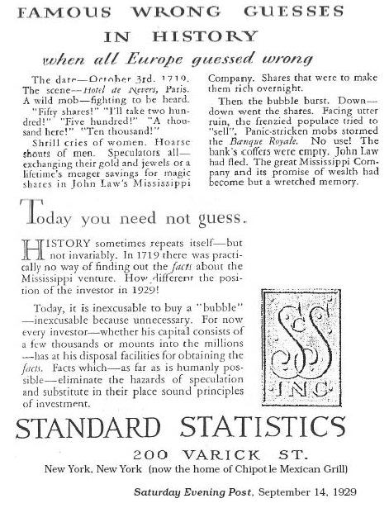
An illustration from 1929
This time is different
elements of fraud, speculation
We now have the information needed to avoid investing in bubble stocks
Dated: Sep 14, 1929
Wall St crash: Oct 29, 1929

Slide 26
Debt intolerance and sovereign default
“Extreme duress many EMEs experience at debt levels that would be manageable in more advanced economies”
There is no single figure that defines a danger point
Reasons:
inherent country differences
role of confidence/willingness of investors to roll over debts
But, risk of default is significantly correlated with debt ratios
For EMEs, external debt/GDP>35-40% is generally a risk

Slide 27
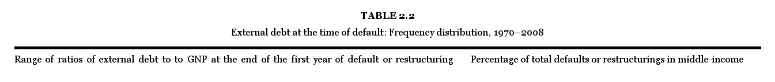
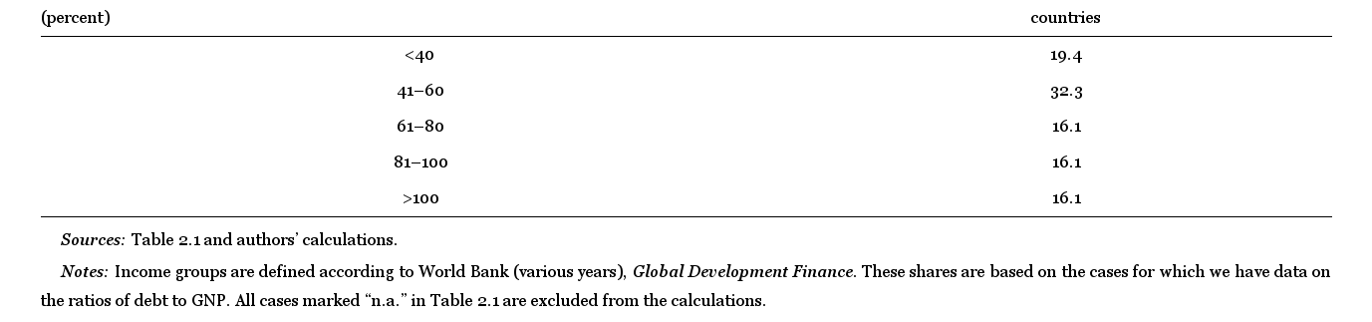
Most defaults occur at debt/GDP>40%

Slide 28
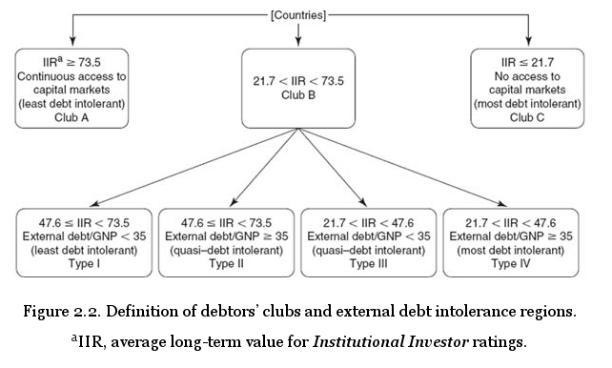
Clubs and regions (Interaction of debt and confidence)

Slide 29
Implications
No definitive metric, but a continuum of conditions on the scale of debt accessibility/intolerance
Countries can move in both directions on the scale
Modern advanced economies generally started at the Club C end and moved over time towards Club A
Argentina 2003: an example of “reverse graduation”
Complex interrelationship between debt intolerance, debt repayment behaviour and growth
Track record of good repayment behaviour can be considered as an investment

Slide 30
Further observations
Debt reduction is hard
Historically, major reductions in debt ratios have often been achieved by either default or inflation
Empirically, capital flows to debt-intolerant countries tend to be pro-cyclical
due to role of confidence in assessments of credit-worthiness

Slide 31
Global database
RR conclusions are drawn from a global database assembled for this book
Key variables
inflation
exchange rates
metallic content of currencies
real GDP
exports
public debt
commodity prices
interest rates
66 countries, accounting for around 90% of world GDP
Of these, only 16 have never defaulted on sovereign debt

Slide 32
Theoretical underpinnings of debt crises
Differences between sovereign crisis and corporate bankruptcy
element of choice in government default
lack of overarching legal authority
Two questions:
Governments generally have command of sufficient resources, in principle, to repay debts. So, why do defaults occur?
Conversely, why repay if repayment can’t be compelled?

Slide 33
Cost/benefit approach to loan repayment/default decision
RR argue for a cost/benefit approach to thinking about the loan repayment decision
Benefits of repayment:
value of reputation and future market access
interlinkage with trade credit
interlinkage with FDI
value of wider international relationships and trust
Cost: the loan itself

Slide 34
Default and non-default equilibria
Generally, some probability of default exists when loans made
Theoretical literature models reasons why there can be both default and non-default equilibria at a point in time
“Confidence” factor can cause a shift from one equilibrium to another
Cost of repayment rises in a panic (eg higher risk premiums demanded)
Rationality of investor run depends partly on the number of investors (easier for a single investor to decide not to panic – Sachs)
Panic can cause illiquidity which can force a default (role of foreign currency debt)
Availability of official back-up (eg IMF facilities) may encourage partial default solutions (moral hazard argument)

Slide 35
Partial default
Most defaults are partial, rather than full debt repudiation
Repayment amount is generally a result of negotiation, on cost-benefit grounds
Rescheduling: a form of partial default
eg delayed repayment with no interest penalty
reduces NPV of loan repayment
Brady bonds (1980s) an example

Slide 36
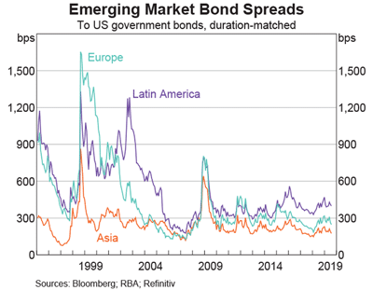
Lender rationality Why lend to a potential defaulter?
Risk premium on debt compensates for risk of default
Risk premium of the order of 5 – 10 percentage points not uncommon for high-risk borrowers (see chart)
Cost of borrowing rises in a crisis – procyclical behaviour
Expected loss = PD X LGD
eg, a 10% chance of losing half your investment
implies:
EL = 0.1 X 0.5 = .05 (=5%)

Slide 37
Distinction between external and domestic sovereign debt
Three characteristics
1. Legal jurisdiction of debt contract
2. Currency of denomination
3. Residency of creditors
In practice these three characteristics are highly correlated
RR consider that 1 is the key test
I argue that 2 is also very important

Slide 38
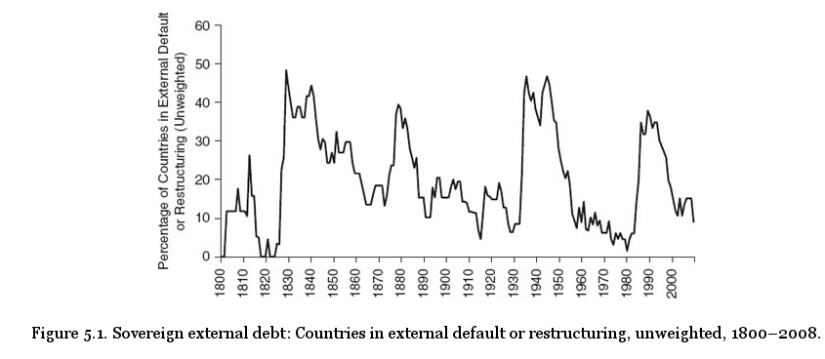
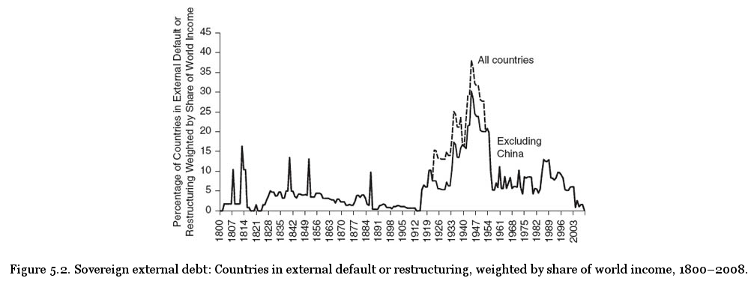
Cycles of external sovereign default

Slide 39
General observations
In terms of number of countries, default events are relatively common
These events come in cycles, sometimes associated with war-time
Correlated with banking crises, for various reasons:
growth, commodity prices, effect on capital flows, banking “contagion”, effects on confidence
Also correlated with:
inflation (a form of default with common causes)
commodity price cycles

Slide 40
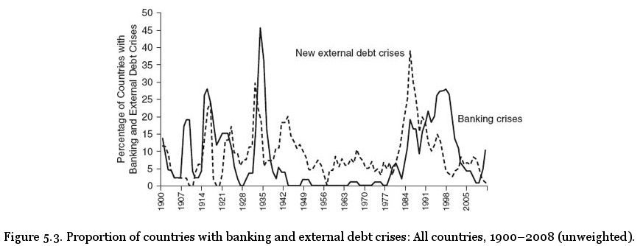
Debt and banking crises

Slide 41
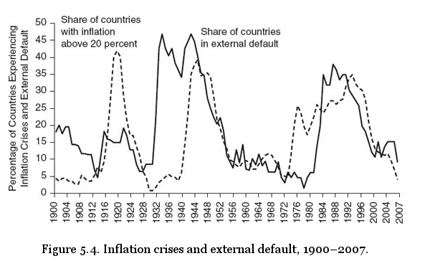
Default and inflation

Slide 42
Global factors
Commodity prices
flows of development capital are often directed to primary commodity exporters
these flows tend to be pro-cyclical
hence, a fall in commodity prices may precede a crisis
Aggregate capital flows
lending from capital exporters can be pro-cyclical for a range of other reasons

Slide 43
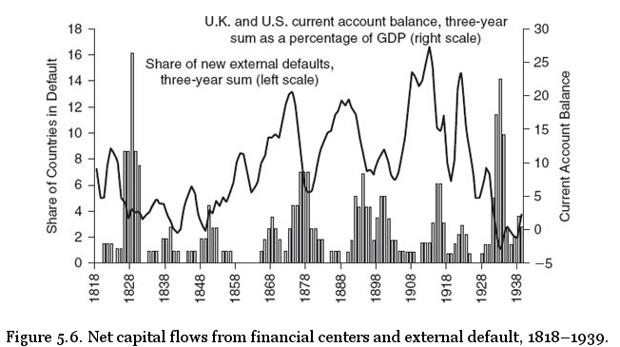
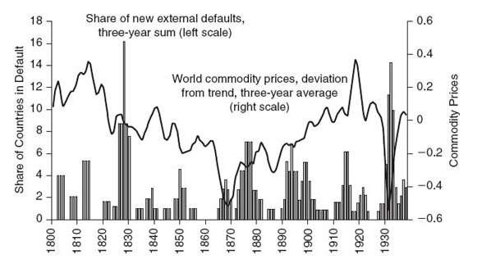
Global factors and external default
Commodity prices
Current account balances

Slide 44
Duration of default
Defined as years from initial default event to resolution/agreement with creditors
Duration has shortened in the post WW2 period
RR propose two explanations:
better resolution mechanisms
availability of bailouts (IMF) makes it easier for parties to settle

Slide 45
History of external default
Most (but not all) countries began their borrowing history as serial defaulters
Recall the risk premium/lender rationality argument: this behaviour not necessarily irrational
Concept of “graduating” to reliable non-defaulter status (eg France, no defaults since 18th C)
Low-risk status as an investment that can be built up over time (or lost quickly)

Slide 46
General patterns of sovereign external default
19th century defaults often associated with stress of war-time
Post-colonial political instability
Clusters of defaults involving Spain, Latin America
20th C defaults more geographically widespread, including Africa and Asia
Global cluster of defaults in great depression – widespread financial distress
Post 1970s clusters of defaults in Eastern Europe and Latin America

Slide 47
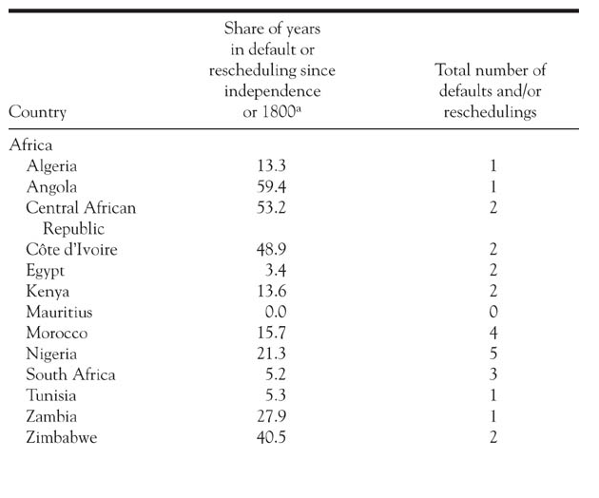
Summary of international experience

Slide 48
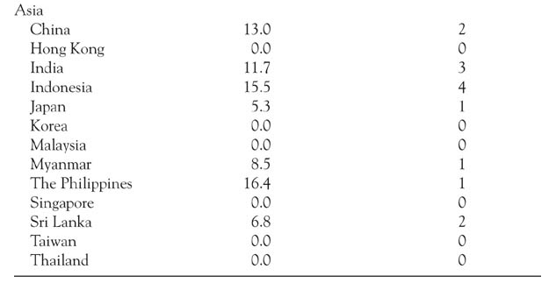

Slide 49
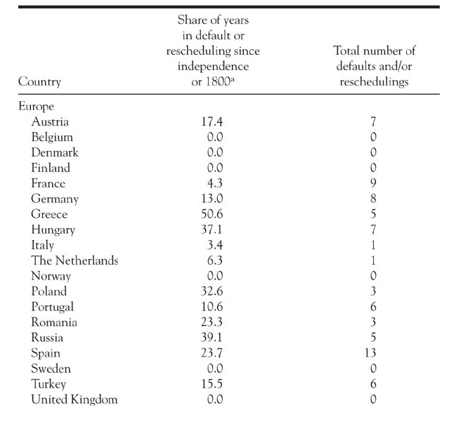

Slide 50
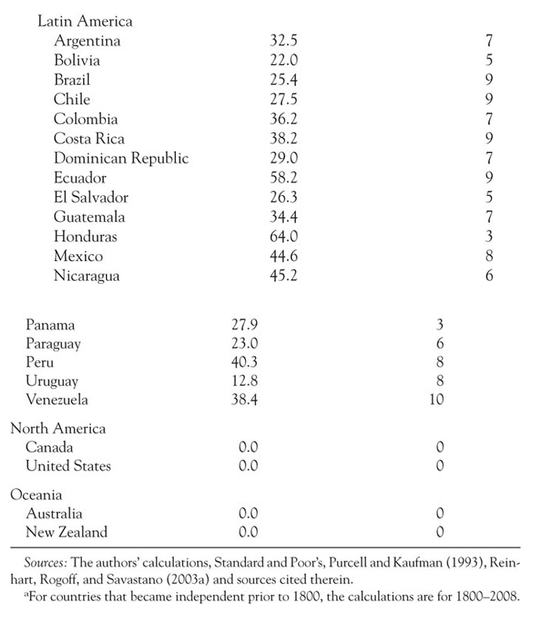

Slide 51
Explanations/interpretation
Because of the complex interaction of history, institutions, confidence, there is no fully determinative theory, only some general patterns and tendencies
Common to spend a lot of time in default post independence
But not inevitable
A small number of “never defaulters”
mainly “new anglo” and East Asian countries
Default more common in Latin America than elsewhere
Possible role of “soft factors” like governing institutions, political stability in explaining default frequency

